Slide 1


CivicConnect – AI-Powered Citizen Reporting App
Smart Governance Through Citizen Participation
Presented by: Prakhyat Singh | 12218463
SIH ID: SIH25031

Slide 2


The Challenge: Unreported and Unresolved Civic Issues
Invisible Problems
Cumbersome Reporting
Potholes, broken streetlights, or sanitation issues often go unseen by city authorities, leading to prolonged neglect.
Existing reporting systems are typically slow, hard to navigate, or demand lengthy, non-transparent complaint procedures.
Lack of Transparency
Citizens lack real-time visibility into the status of their reports, breeding frustration and distrust in local governance.

Slide 3









Our Objective: Bridging Citizens and Authorities
Instant Reporting
Efficient Management
Enable citizens to report civic issues instantly using location and imagery.
Provide administrators with tools to efficiently manage, verify, and resolve issues.
Community Building
Accountability
Encourage active citizen participation in the maintenance and improvement of their city.
Introduce a transparent, trackable system to foster greater accountability in local services.

Slide 4


Introducing CivicConnect: Mobile Reporting Made Easy
A Seamless Reporting Workflow
Users capture an image of the issue on their Android device.
The app automatically detects and registers the precise geographical location (GPS).
Users categorise the issue (e.g., Road, Water, Waste) and submit it.
The report is instantaneously delivered to the Admin Panel for verification and action.
Admins can then update the status, which is reflected in the user's dashboard.
Built entirely using Kotlin, CivicConnect ensures a native, responsive, and reliable experience for all users.

Slide 5





Key Features: Intelligence and Transparency
Location-Based Reporting
AI-Generated Priority Score
Automatic GPS detection ensures accurate placement of reported issues for rapid response.
Utilises the Gemini API to calculate urgency and automatically prioritise critical civic issues.
Real-Time Tracking
Secure & Scalable Backend
Citizens receive instant updates on their report status: Pending, In Progress, or Resolved.
Leverages Firebase Authentication and Firestore for robust data management.

Slide 6


System Architecture: Data Flow
Our backend is designed for speed and reliability, ensuring smooth communication between all stakeholders, underpinned by Google's cloud infrastructure.
User Report
Firebase
Gemini API
Admin Dashboard

Slide 7





Technology Stack: Modern and Efficient
Mobile Frontend
Cloud Backend
Built natively with Kotlin and XML for performance and native Android look and feel.
Uses Firebase (Auth, Firestore, Storage) for real-time data synchronisation and user management.
AI & Intelligence
Design Pattern
Gemini API is integrated for advanced analytical tasks, specifically priority scoring of reports.
Employing MVVM Architecture for clean separation of concerns and easier maintenance.

Slide 8



Impact: Benefits for the Citizen
Effortless Reporting
Report issues in seconds with a photo and a tap, eliminating complicated official forms.
Informed Participation
Stay continuously updated on the progress of their complaints via real-time notifications.
Empowered Community
Fosters a sense of ownership and accountability, leading to more engaged community participation.

Slide 9
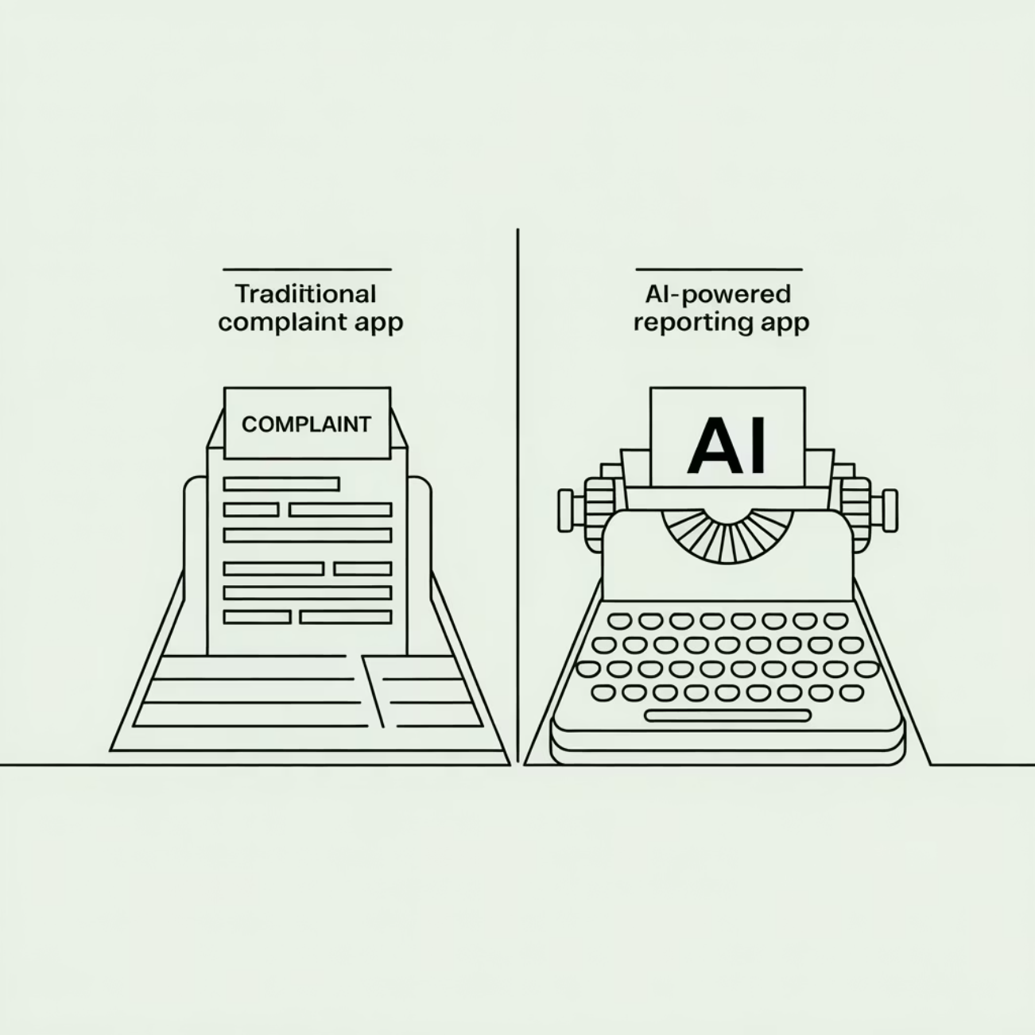


The CivicConnect Advantage: AI-Driven Prioritisation
While many existing apps simply log complaints, CivicConnect is differentiated by its focus on intelligent workflow and administrative efficiency.
AI Urgency Ranking: Uses the Gemini API to assess the severity of the issue and assign a Priority Score, ensuring urgent problems are tackled first.
Dual Focus: Designed for both citizen convenience and administrative efficiency in handling large volumes of reports.
Performance: The Firebase backend guarantees lightning-fast data handling and reliability, crucial for public service applications.

Slide 10





Future Vision and Enhancements
To scale CivicConnect into a comprehensive city management tool, we plan the following additions:
Advanced Analytics
Implementing dashboards for tracking issue trends and identifying service hotspots.
Administrative Integration
Seamlessly connecting with local government officials on the same platform.
AI Based Prioritization
AI driven prioritization to ensure that the most critical issues are addressed first.
Similarity Detection
Using AI to group duplicate reports, reducing redundant administrative work.

